Slide 1
Stroke Prediction Data EDA Project
Augi Bold

Slide 2

Stroke Prediction Dataset https://www.kaggle.com/fedesoriano/stroke-prediction-dataset.
Stroke is the 5th leading cause of death and disability in the United States (American Heart Association)
Every 40 seconds in the US, someone experiences a stroke and every 4 minutes, someone dies from it according to the CDC.
A recent figure of stroke-related cost almost reached $46 billion.
Through this project, I explored which factors are the leading drivers for stroke to bring awareness to individuals and lay the basic analysis for future work in building a predictive model using Machine Learning which would be beneficial to hospitals and insurance companies in estimating risk and pricing.

Slide 3
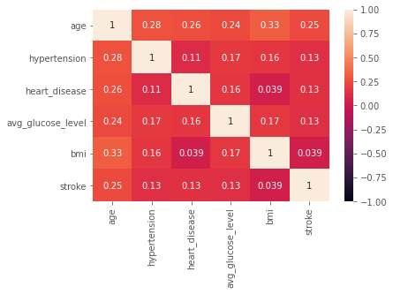
Dataset:
5110 x 12 attributes
- 3 numeric & continuous
- 7 categorical attributes

Slide 4
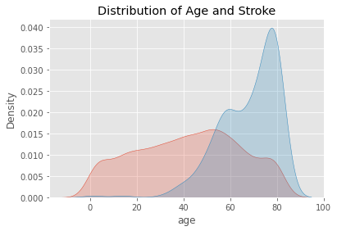

Slide 5
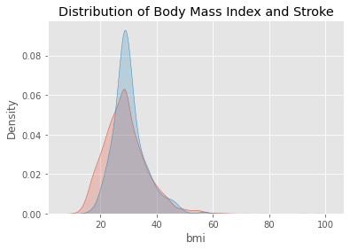

Slide 6
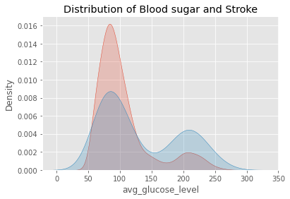

Slide 7
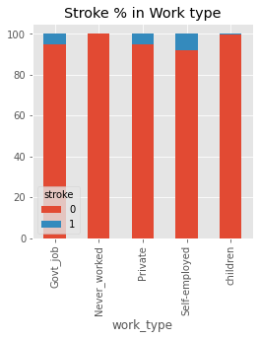
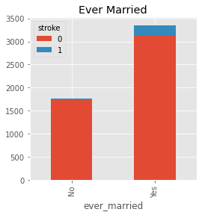
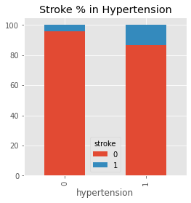
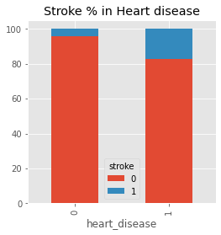
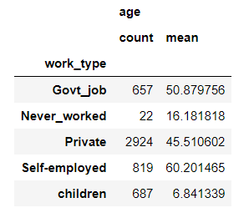
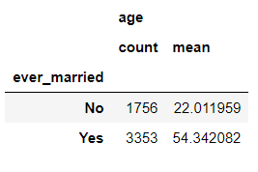
Many categorical features attributed to Age

Slide 8
Learnings
Age is a strong driving factor for Stroke risk and was the strongest attribute in this dataset.
Contrary to my assumption, BMI & Blood sugar were not correlated to risk of Stroke. This came as a surprise as BMI is used to diagnose obesity which is linked to other risks.
However, as seen from data there was association between a third of all strokes to people who had a blood sugar level that was in the diabetic category. So diabetes is a risk for stroke because it raises the risk by 1.5 times.
Sometimes what seems to be a correlation on the surface isn't. For example, attributes like Hypertension, ever_married and smoking_status all upon further analysis, ended up pointing to age rather than being correlated to risk of stroke.
In data cleaning, when dealing with null values, it's good to check what impact they may have in the target feature before removing them.
For future and if I had more time, I would learn how to build predictive models using Machine Learning so I can extract value in a business context for hospitals and insurance companies in estimating risk and pricing.

Slide 9
Questions?

